Slide 1


MonitorAssistant : Simplifying Cloud Service Monitoring via Large Language Models （FSE 2024）

Slide 2

Work of this paper
01
Background：
Large-scale cloud system（metric and incident）
Problem：
No Standard for anomaly detection in real scenarios：
What is ‘anomaly’ ?
What should we do in anomaly detection ?
Existing methods do not have interpretability：Although academic approaches have achieved good performance, Industry predominantly uses simple, efficient methods due to better interpretability and ease of implementation.
知行合一、经世致用
自强不息 厚德载物
Central South University
Notes:
学术界的异常检测不是实际应用所需要的

Slide 3
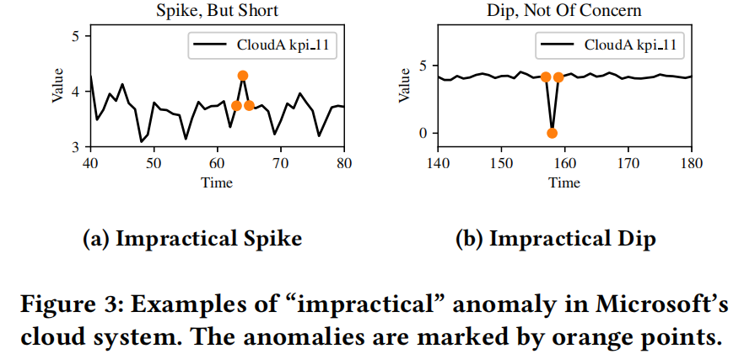
Requirement analysis
02
What is ‘anomaly’ ?
Define ‘Practical Anomaly’：
With anomaly in metric data.
Combine with a incident.
2. What should we do in anomaly detection ?
Recognize metric anomaly. (Accuracy)
Offer further explanations and correspondin troubleshooting recommendations. (Interpretability)
Offer engineers an friendly interaction process with a low algorithmic threshold. (Dynamic correction detection model)
Goal
知行合一、经世致用
自强不息 厚德载物
Central South University
Notes:
根据上述问题，结合场景做了一个需求分析

Slide 4
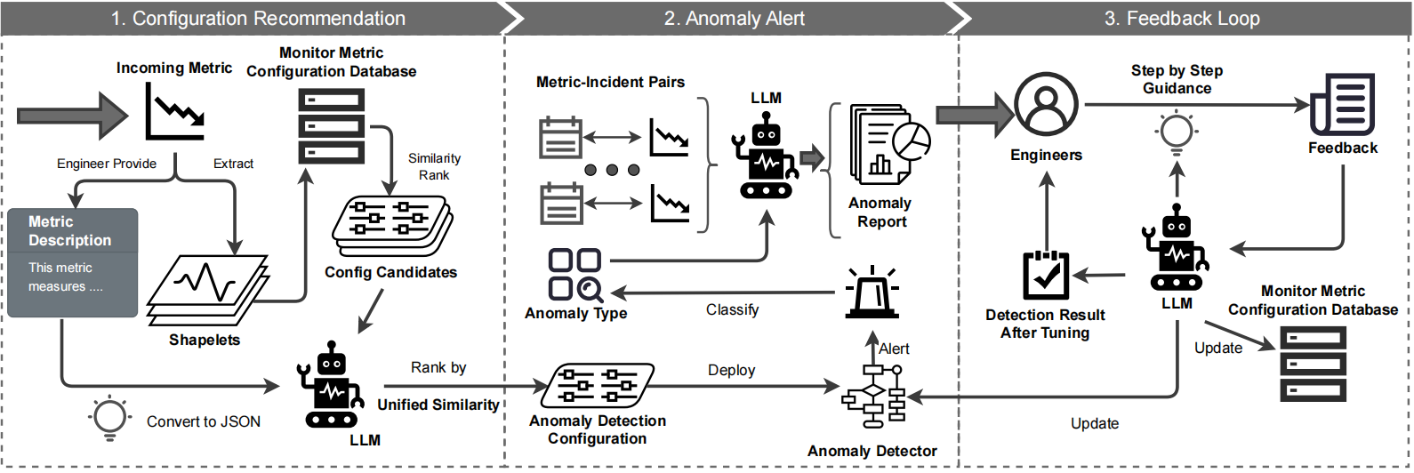
Method
03
知行合一、经世致用
自强不息 厚德载物
Central South University

Slide 5
Method
03
Utilizing both traditional method and deep learning method to improve detection accuracy
In database，for every historical examples：
{metric feature，Description， Configuration}
Similarity sorting based on metric
Similarity sorting based on description
Configuration recommendation
知行合一、经世致用
自强不息 厚德载物
Central South University

Slide 6
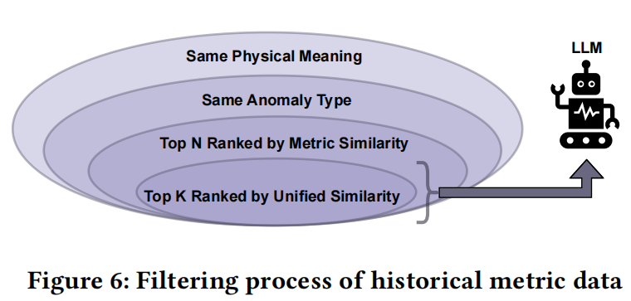
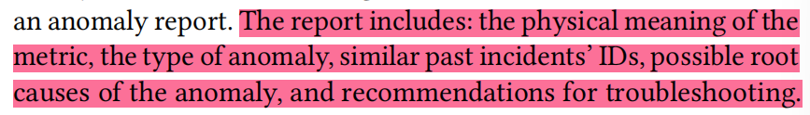
Method
03
Generating Interpretable report base on historical metric-incident pairs.
知行合一、经世致用
自强不息 厚德载物
Central South University

Slide 7
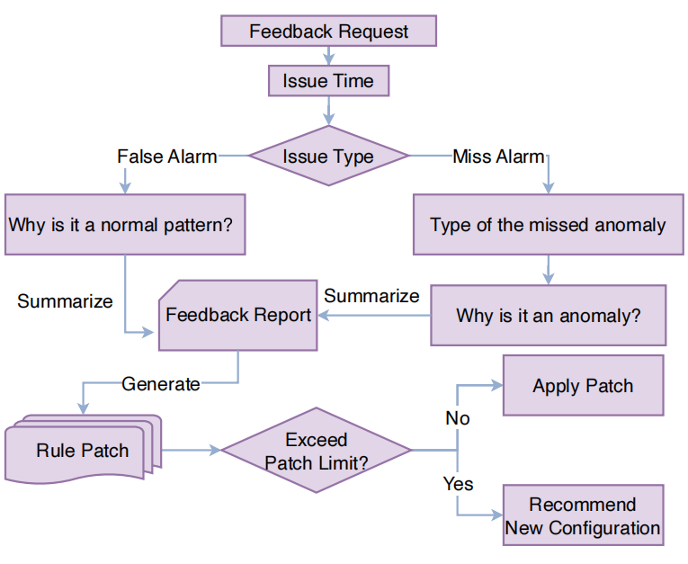
Method
03
Algorithm engineers do not understand system performance indicators, and service engineers do not understand detection algorithms.
Set up an interaction process for service engineers to guide model correction through large models.
知行合一、经世致用
自强不息 厚德载物
Central South University

Slide 8
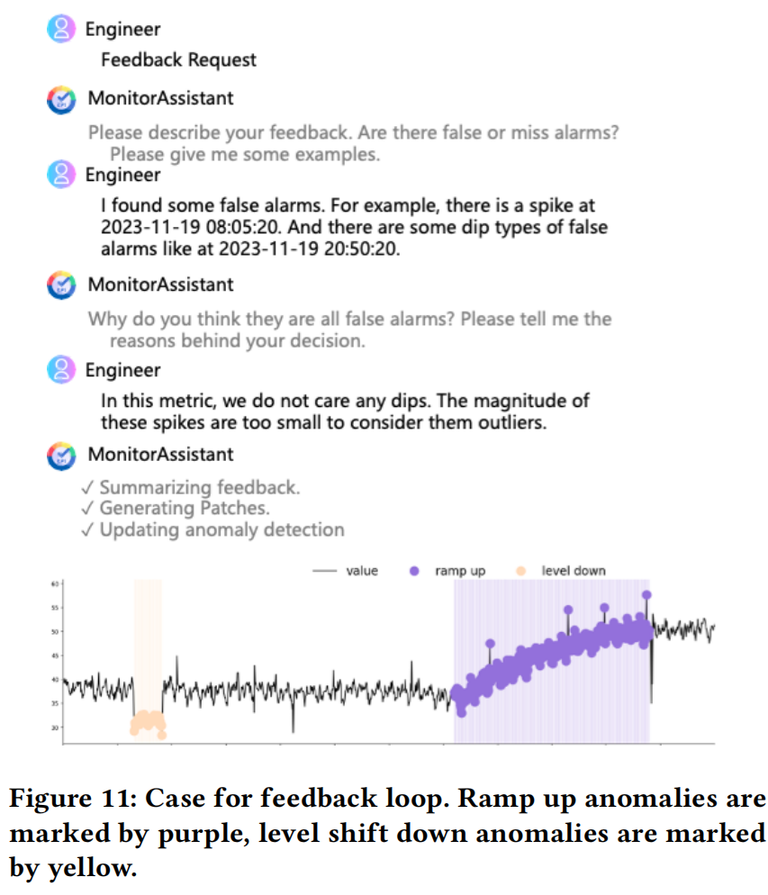
Case
04
知行合一、经世致用
自强不息 厚德载物
Central South University

Slide 9


谢 谢 大 家
THANKS FOR ALL

